Slide 1


INTRODUCTION
S S GOH
VOLUNTEER INSTRUCTOR
PI PYTHON COMMUNITY
LEARNX COMMUNITY – TAMPINES REGIONAL LIBRARY (NLB)
https://learning.nlb.gov.sg/communities/join/digital-communities
“Let’s make our learning communities a warm, welcoming and safe space.”

Slide 2
LEARNX COMMUNITY
PROMOTE COMMUNITY LEARNING
LED BY VOLUNTEERS
PI – PYTHON COMMUNITY
PROFILE OF OUR PARTICIPANTS
NEWBIES
DON’T KNOW HOW TO GET STARTED
CURIOUS
A PRACTICAL APPROACH TO LEARN PYTHON
EASY TO UNDERSTAND
ENGAGING
ENTERTAINING

Slide 3

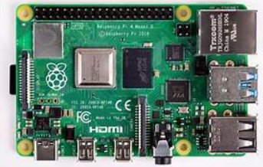
TOUTED AS THE WORLD’S SMALLEST COMPUTER, THE SIZE OF A CREDIT CARD
THE BRAINCHILD OF PROF EBEN UPTON OF CAMBRIDGE UNIVERSITY
AN INEXPENSIVE WAY TO PROMOTE LEARNING, TINKERING AND EXPERIMENTATION IN COMPUTING
USED EXTENSIVELY FOR STEM EDUCATION IN EUROPE / US
THE OS COMES PRE-INSTALLED WITH PYTHON AND ALL THE LIBRARIES THAT ARE NEEDED TO KICK START THE LEARNING PROCESS

Slide 4
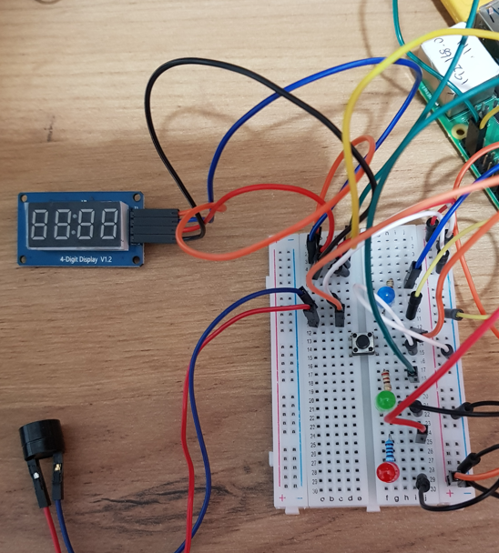
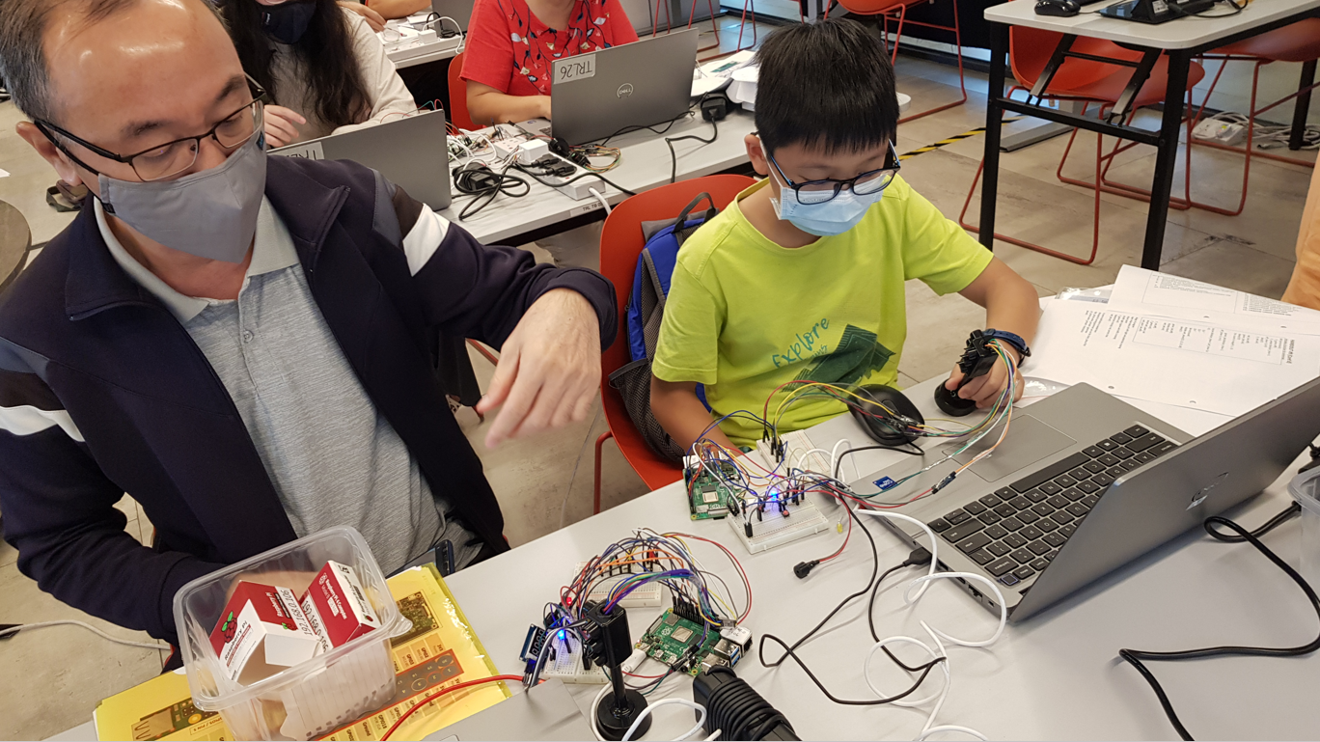
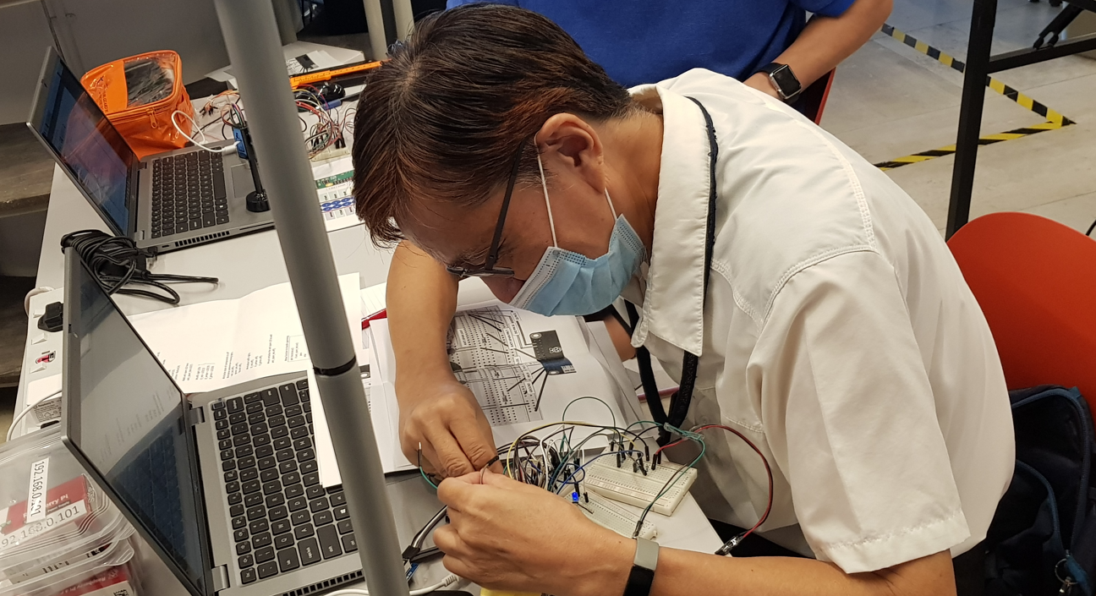
MEETS THE CRITERIA OF OUR COURSE OBJECTIVES
PARTICIPANTS GETS TO:
WORK DIRECTLY WITH IT
WRITE CODES TO INTERACT WITH IT
SEE THEIR CODES/CIRCUITS COME “ALIVE” INSTANTANEOUSLY

Slide 5
PROGRAMMING CONCEPTS
LIBRARIES
VISUAL UNDERSTANDING OF VARIABLE
OOP IN LAYMAN TERMS
Objects and Methods
AN APPLICATION
ALGORITHM
CODE
TEST
DEBUG

Slide 6
PROGRAMMING CONCEPTS
LIBRARIES
VISUAL UNDERSTANDING OF VARIABLE
OOP IN LAYMAN TERMS
PROBLEM SOLVING
ALGORITHM
CODE
TEST
DEBUG
>>> from gpiozero import LED
>>> from time import sleep

Slide 7
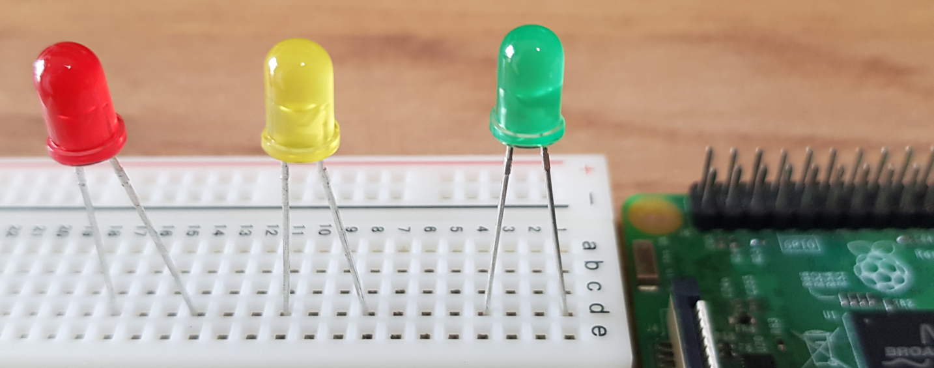
PROGRAMMING CONCEPTS
VISUAL UNDERSTANDING OF VARIABLE
OOP IN LAYMAN TERMS
Objects
Methods
AN APPLICATION
ALGORITHM
CODE
TEST
DEBUG
>>> from gpiozero import LED
>>> from time import sleep
>>> red_led=LED(13)
>>> yellow_led=LED(19)
>>> green_led=LED(26)
>>> from gpiozero import LED
>>> from time import sleep
>>> red_led=LED(13)
>>> yellow_led=LED(19)
>>> green_led=LED(26)
>>> green_led.on()
>>> green_led.blink()
>>> red_led.on()

Slide 8
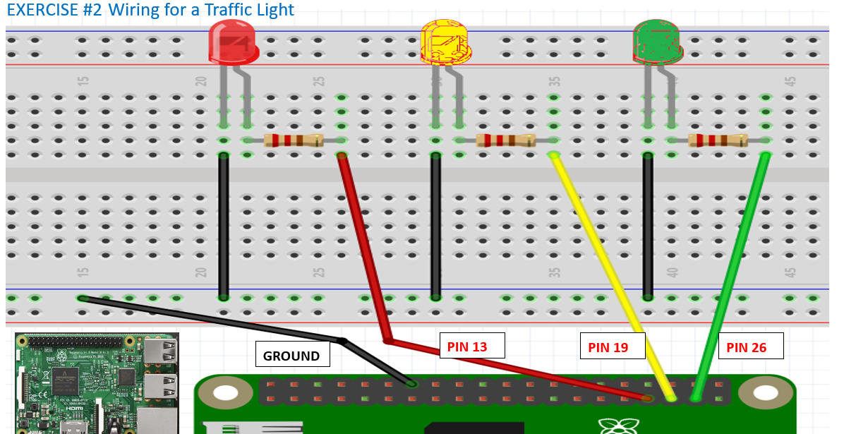
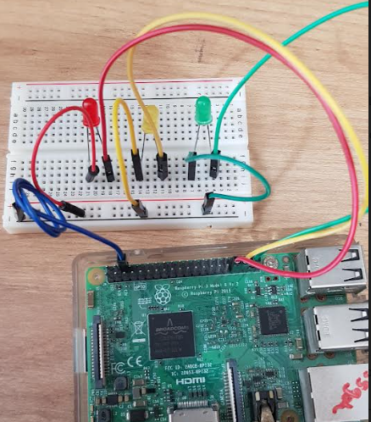

FROM CONCEPTS TO APPLICATION
AN APPLICATION
ALGORITHM
CODE

Slide 9
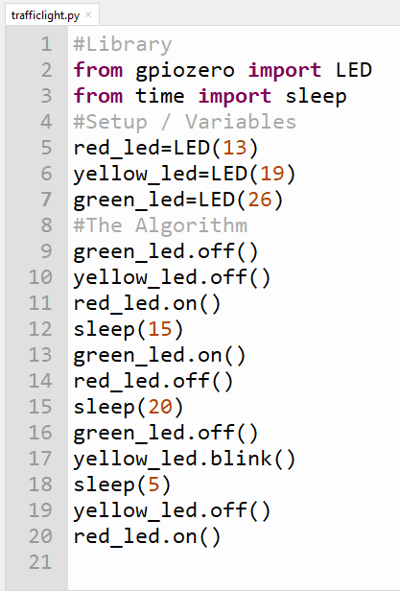
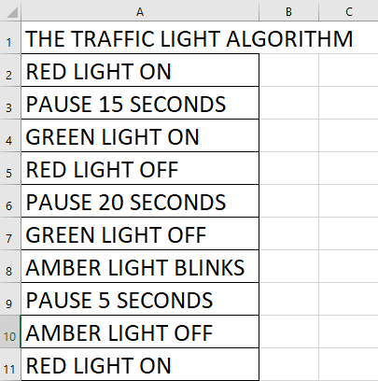
FROM CONCEPTS TO APPLICATION
AN APPLICATION
ALGORITHM
CODE

Slide 10
RUN, TEST, DEBUG
TEST
DEBUG
TYPES OF ERRORS
SYNTAX ERRORS
LOGICAL ERRORS
CIRCUITRY ERRORS

Slide 11
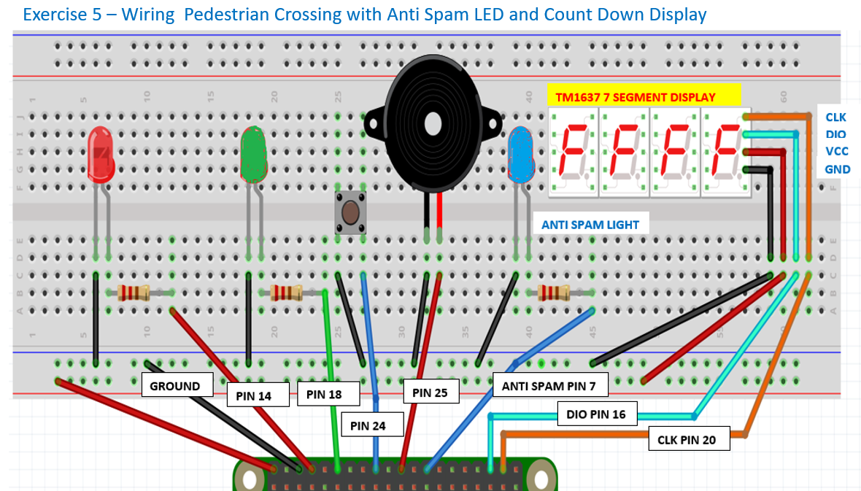
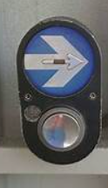
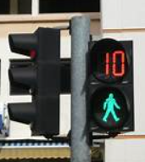
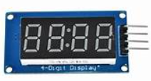
ADVANCED APPLICATIONS
A VISIBLE FOR LOOP EXAMPLE

Slide 12
SUMMARY
LIFE BEYOND CURRICULUM
THERE’S NO WAY YOU CAN TEACH SOMEONE EVERYTHING
PROMOTE SELF-LEARNING
FIND SOMETHING USEFUL TO PURSUE
JOIN PI CLUB COMMUNITY
BE PART OF LEARNX TO TEACH OTHERS

